Slide 1
COP 290 ASSIGNMENT 2
Ankit Kumar Meena(2022CS11131)
Umesh (2022CS11111)

Slide 2
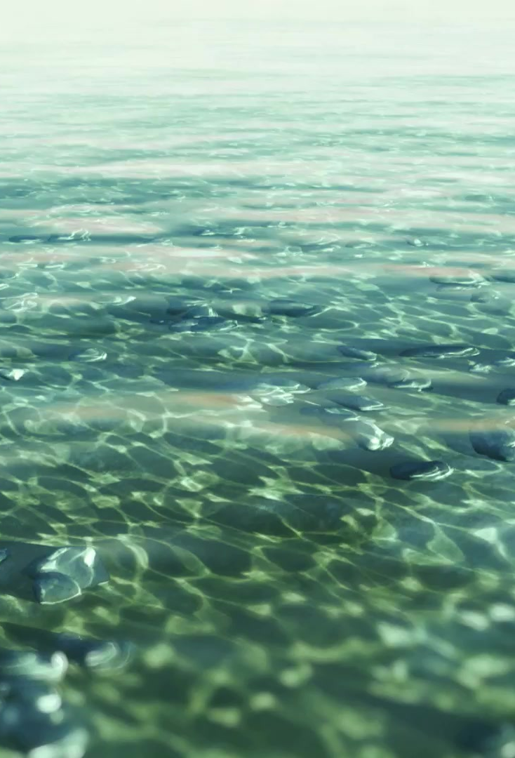
INTRODUCTION
In response to the profound impact of climate change on Earth, our game seeks to address the urgent need for environmental conservation and action. Focusing on the critical issue of ocean pollution, this game serves as a platform for players to engage in virtual ocean cleanup efforts. As our planet faces increasing environmental degradation, this initiative offers a proactive and immersive experience aimed at raising awareness and inspiring action to combat climate change.

Slide 3

Game overview
Overworld:
The overworld serves as the introductory environment where players witness the devastating effects of climate change. They'll observe a damaged ecosystem, with dying plants and polluted water, highlighting the urgent need for action.
Ocean Cleanup Game:
Players engage in an interactive ocean cleanup mission, navigating through polluted waters to collect debris and restore marine life. Using various tools and strategies, they'll work to clean up the ocean and mitigate the harmful effects of pollution.
Factory Fixing Game:
Inside the overworld, players also encounter a malfunctioning factory that's contributing to pollution. In this mini-game, players must fix the factory's operations to prevent further pollution and promote sustainable practices.

Slide 4
TOOLS Used
Python (Pygame): The game development was primarily done using Python with the Pygame library, providing a powerful framework for creating 2D games.
Tiled Map Editor: Tiled was used to design and create the maps for both the overworld and industrial areas. It allowed for the efficient layout of tiles and objects to build the game environments.
Pytmx Library: Pytmx was utilized for loading the Tiled maps into the game. This library enabled seamless integration of the maps created in Tiled with the game code.
Canvas (Pygame): A simple canvas was created using Pygame for the ocean cleanup game. This provided the necessary drawing area for implementing the game mechanics and visual elements.
These tools were instrumental in developing various aspects of the game, from designing the game world to implementing gameplay mechanics.

Slide 5
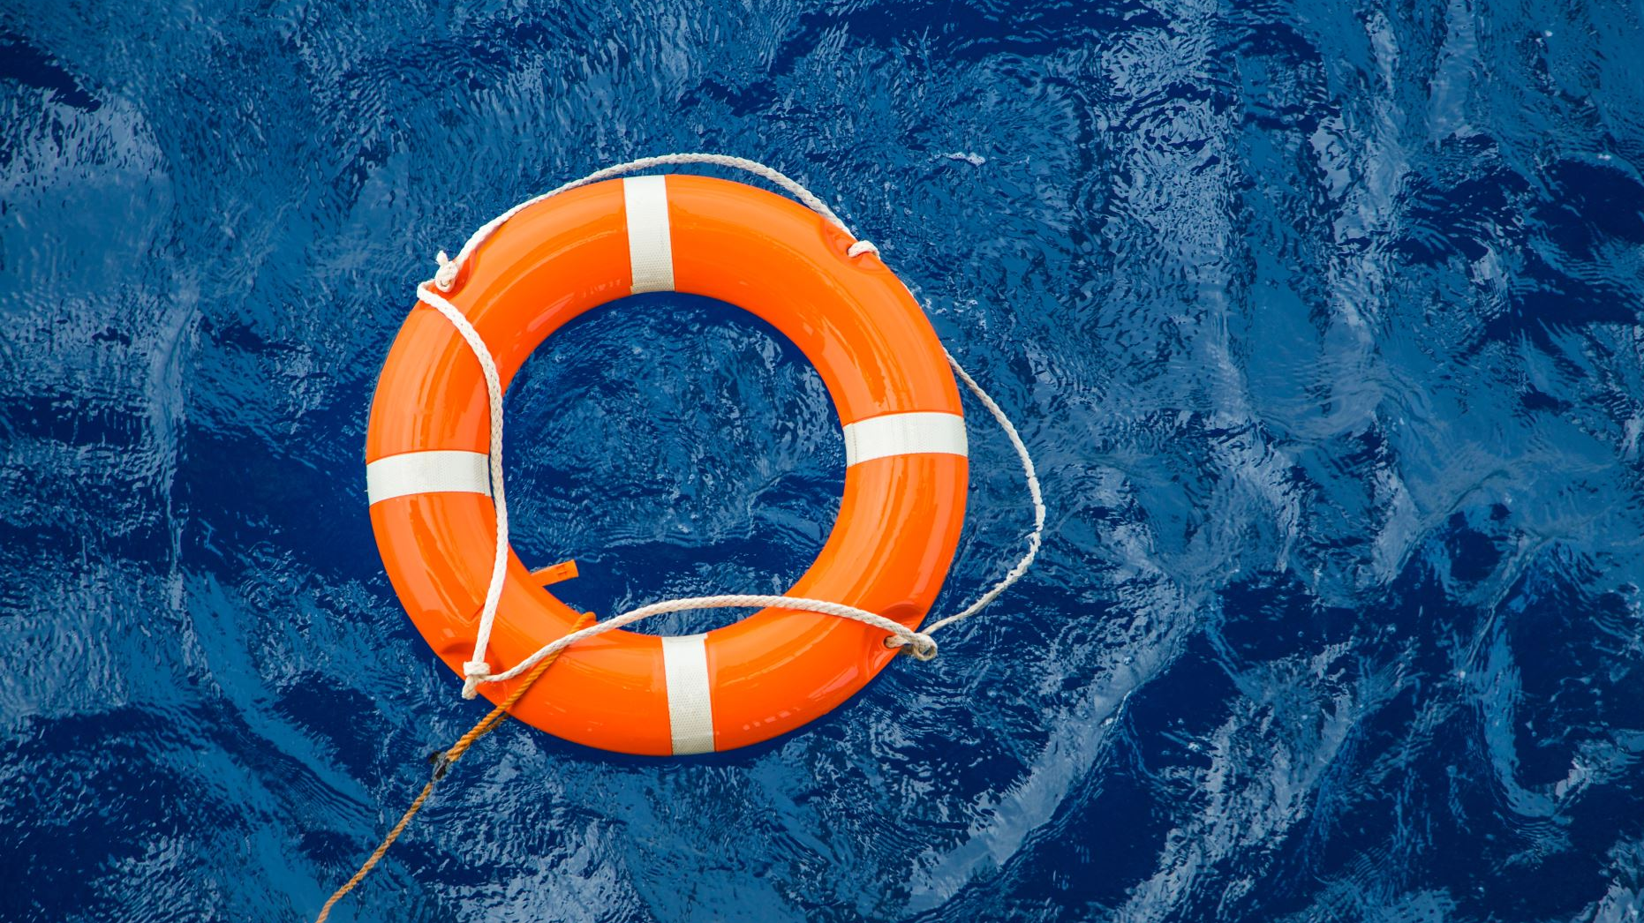
OCEAN cleanUP
Design Choices:
Underwater Theme: The choice of setting the game in the ocean aligns with the overall theme of environmental conservation and highlights the importance of ocean cleanup efforts.
Submarine and Spaceship Elements: Incorporating submarines and spaceships adds an adventurous element to the game and enhances the player's immersion in the underwater environment.
Trash and Nets: The inclusion of various types of trash and nets adds diversity to the gameplay and reinforces the message of cleaning up the ocean.

Slide 6

OCEAN CLEANUP
Gameplay Mechanics:
Trash Collection: Trash falling from above requires quick reflexes from the player to catch them using firing nets. This mechanic challenges the player's timing and precision.
Submarine Movement: Allowing the submarine to move in multiple directions (right, left, up, down) provides the player with control over their movement and adds strategic elements to avoid obstacles and catch trash efficiently.
Collision Effects: Slowing down the submarine's speed upon collision with trash adds a layer of challenge and encourages players to navigate carefully.
Scoring and Progression: Implementing a scoring system based on the number of trash collected incentivizes players to aim for higher scores. Moving to the next stage upon reaching a certain score threshold introduces progression and keeps players engaged.
Penalties: Introducing penalties for missing trash or nets (such as being eliminated after missing five) adds stakes to the gameplay and motivates players to maintain focus and accuracy.
Next Stage: Transitioning to a different gameplay mechanic in the next stage (using a spaceship to destroy collected trash and nets) adds variety and excitement, ensuring that the game remains dynamic and engaging.

Slide 7
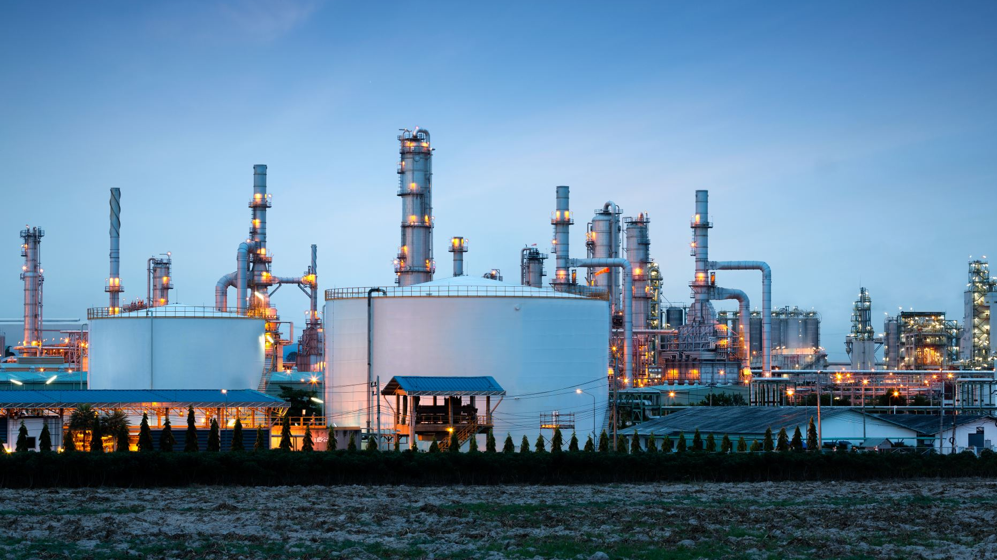
What’s next
Malfunctioned Factory Pollution:
Even after completing the second stage of the ocean cleanup game, the water remains polluted due to a malfunctioned factory continuously discharging waste.
The factory serves as the next target for environmental restoration efforts.
Journey Through the Overworld:
Players must navigate through the overworld to reach the malfunctioned factory.
The overworld environment reflects the ongoing environmental degradation, motivating players to take action.
Fixing the Factory Game:
Upon reaching the factory, players engage in a new game focused on fixing the factory and stopping the discharge of pollutants.
The objective is to reach the goal point within the factory premises to shut down the discharge mechanism.

Slide 8
Design Choices for the Industry Fixing Game:
Platformer Gameplay:
The game adopts a classic platformer style, allowing players to navigate through levels by jumping between platforms, avoiding hazards, and overcoming obstacles.
Platformer mechanics provide a familiar and engaging experience for players, promoting accessibility and enjoyment.
Obstacles and Challenges:
Levels are designed with a variety of obstacles and challenges that reflect the industrial setting.
Moving Blocks and Machinery:
Dynamic elements such as moving blocks, conveyor belts, and industrial machinery add complexity to level design and introduce new gameplay mechanics.
Players must time their movements carefully to avoid getting crushed or trapped by moving obstacles while traversing the environment.

Slide 9
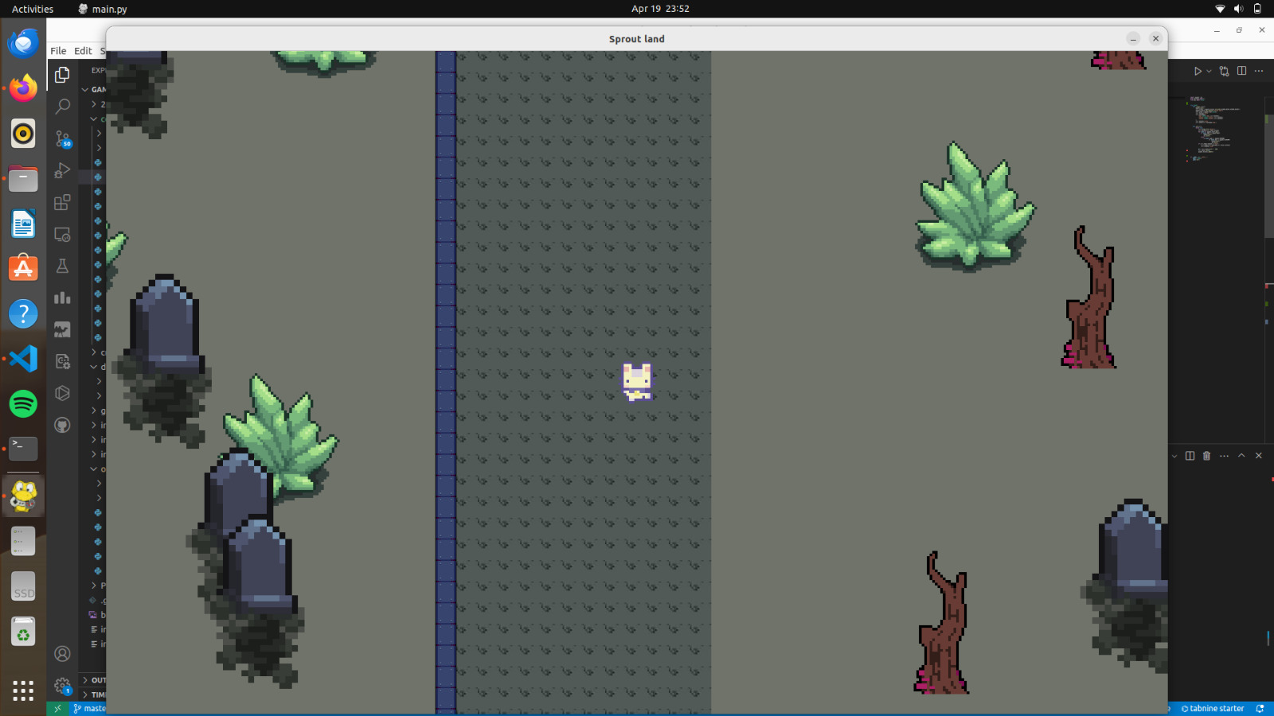
Gameplay images

Slide 10
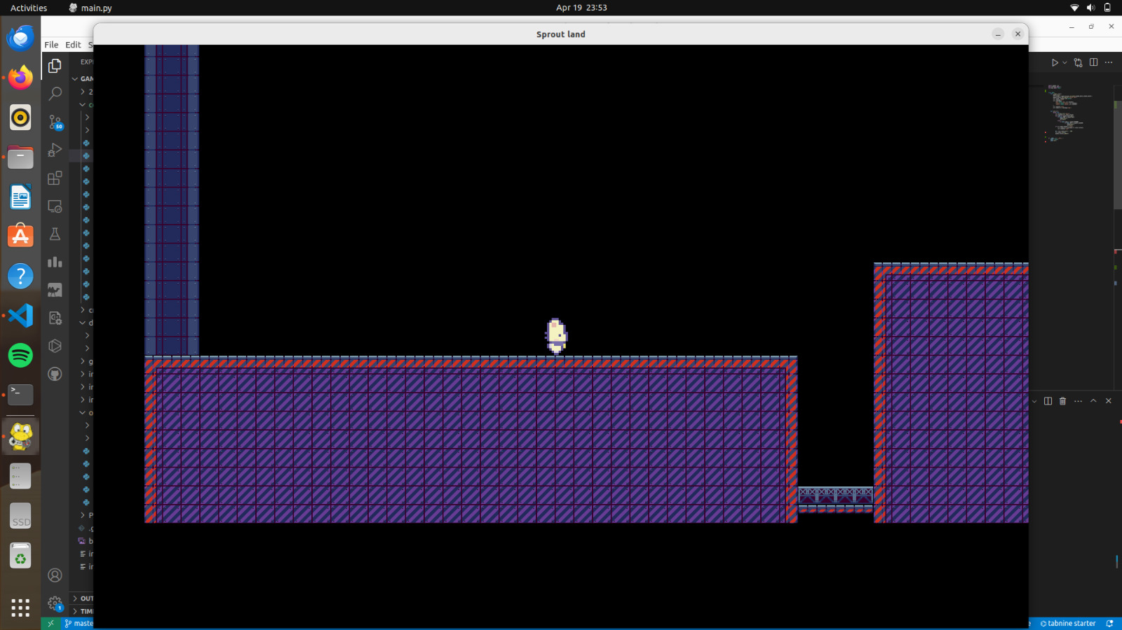
Gameplay images

